Slide 1
Reverse Engineering Models

Slide 2
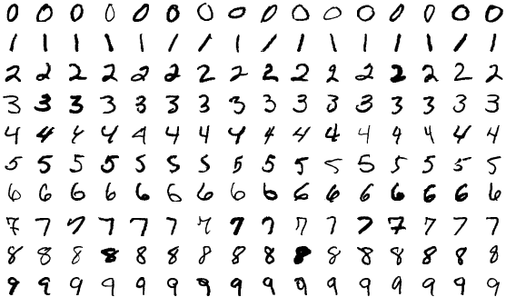
Overview
MNIST Dataset

Slide 3

Training a model
Objective: classify handwritten digits 0-9
calculate loss & update model
Model
Data + Label
Model Architecture
&
Hyperparameters

Slide 4
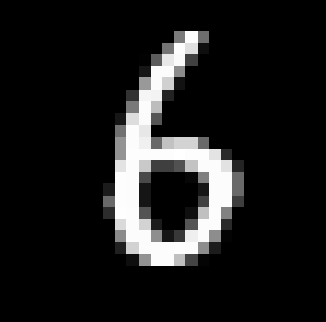
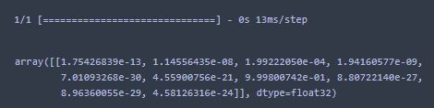
Model Output
Model

Slide 5
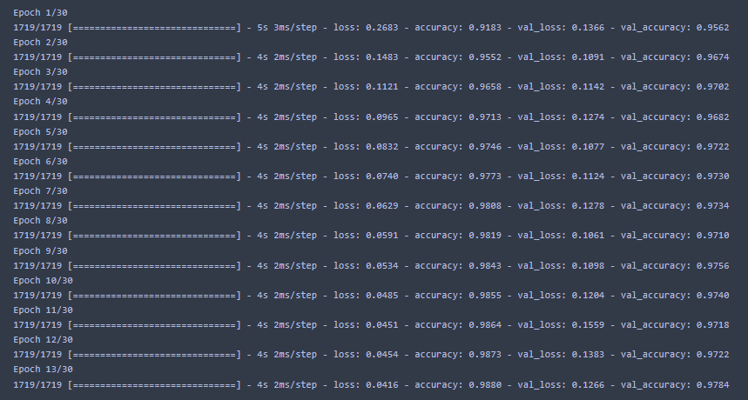
Training acc: 98.8%
Val acc: 97.84%

Slide 6
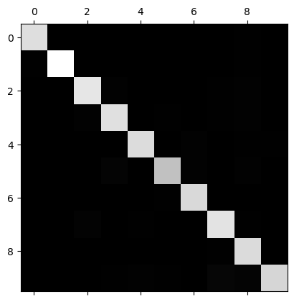
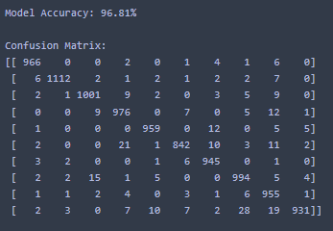
Test Data Results

Slide 7
Reverse Engineering???
API
Download weights
Our Model
ML Model

Slide 8
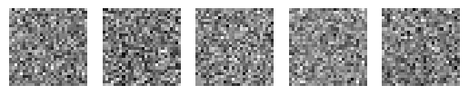
Ideas
Generate random inputs and get distribution and try to overfit model to that
[ 0.22 0.06 0.11 …. ]
API
[ 0.21 0.18 0.09 …. ]
[ 0.42 0.08 0.02 …. ]
ML Model
[ 0.34 0.28 0.01 …. ]
[ 0.01 0.26 0.30 …. ]

Slide 9
Ideas
Generate random inputs and get predicted label and use it as training data
API
3, 5, 9, 2, 4
ML Model

Slide 10
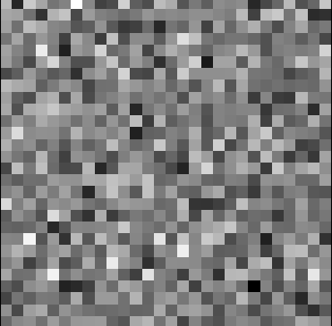
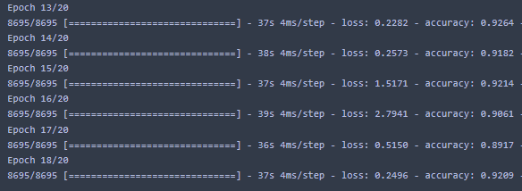
Experiment
6

Slide 11
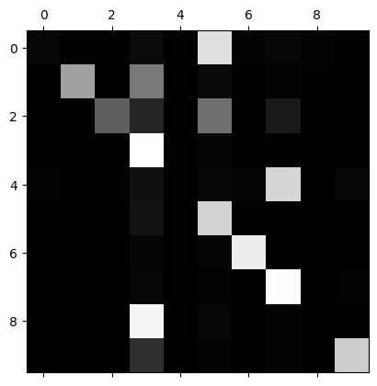
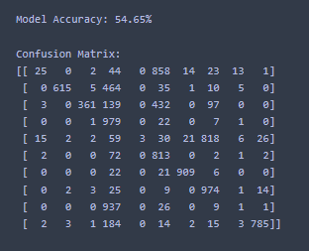
Testing on Real Data

Slide 12
Future Work & Improvements
Larger generated dataset
Larger Network
Try different datasets
Try for continuous value prediction (regression)
Beware:
Class imbalance in generated dataset

